Slide 1

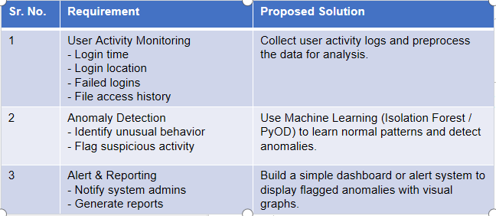
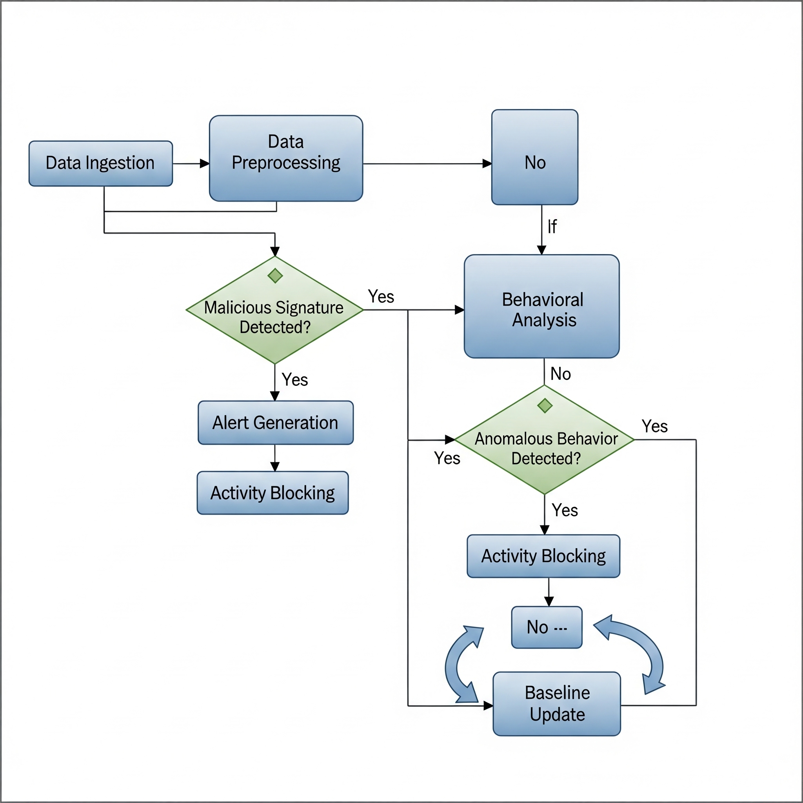

MIT SCHOOL OF COMPUTING
Class : TYCSF 2
Group Id: 07
DEPARTMENT OF COMPUTER SCIENCE & ENGINEERING
User Behavior Anomaly Detection System
Sakshi Sharma, Advait Joshi, Mithilesh Mohane, Suhrud Ghan
Faculty Guide:
Dr. Mohd. Shafi Pathan
SAYS
We're getting too many false positives.
Is this alert a real threat or just noise?
The system is too slow to respond effectively.
DOES
Spends hours manually sifting through logs.
Correlates data from multiple different sources.
Creates incident reports for management.
THINKS
I'm worried I will miss a critical threat.
This process should be more automated.
I need to be more proactive, not just reactive.
FEELS
Overwhelmed by the sheer volume of alerts.
Anxious about missing a genuine security breach.
Frustrated with the inefficiency of current tools.
Proposed Solution
Develop a system that monitors user activity and applies Machine Learning to detect unusual patterns.
Collect features: login time, location, failed attempts, file access.
Train model to learn “normal” patterns.
Flag abnormal behavior as suspicious/anomaly.
Generate alerts for administrators.
Scope and Feasibility
Applications: Banking fraud detection, insider threat monitoring, cloud security, e-commerce fraud prevention.
Feasibility: Can be built using Python libraries (Scikit-learn, PyOD) with synthetic datasets.
Future Scope: Extend to real-time monitoring and deep learning models.
Problem Statement
With increasing cyberattacks, stolen credentials, and insider threats, traditional security mechanisms (passwords, firewalls) often fail to detect malicious activity. Most breaches involve abnormal user behavior such as unusual login times, multiple failed attempts, or accessing sensitive files unexpectedly.

